Slide 1


Microsoft
Data and AI South Florida User Group
November, 2019
Hiram Fleitas
Fleitas Arts
github.com/hfleitas/rig
Notes:
Image ref: https://talesofarcadia.fandom.com/wiki/Toby_Domzalski

Slide 2
Azure Data Factory
From On-Prem to Data Warehouse
Azure Data Factory
Data Store Connectors 80x
On-Premises
DevOps
Automation
Notifications
Resources
Hiram Fleitas
Fleitas Arts
github.com/hfleitas/rig
Notes:
Image ref: https://talesofarcadia.fandom.com/wiki/Toby_Domzalski

Slide 3











Hiram Fleitas
Owner Fleitas Arts
Bio
Father
Principal DB Architect
SSIS since 2009
Developer since 1995
SQL Server since 1999
USCG Auxiliary Flotilla Staff Officer
@hiramfleitas
/hfleitas
hiram@fleitasarts.com
hiramfleitas
fleitasarts.com

Slide 4

DEMO
Azure Data Studio

Slide 5
DEMO
Azure Data Factory

Slide 6
DEMO
DevOps

Slide 7
DEMO
Automation Accounts - Runbooks

Slide 8
DEMO
CTAS & CETAS

Slide 9
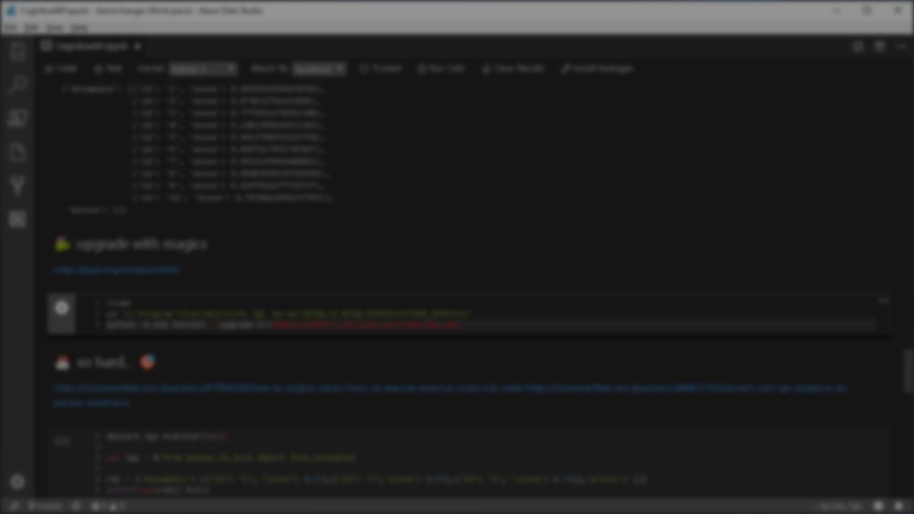


Summary
Azure Data Factory
Azure Data Studio
Parameters
Activities
Connectors
Integration Runtime
DevOps
Automation
Notifications
Resources

Slide 10
Resources
http://fleitasarts.com
github.com/hfleitas/rig
netflix.com/trollhunters
Data Factory: Documentation
Data Factory: Copy Activity Performance
Data Factory: Connector Azure SQL Data Warehouse
Connector SQL Server: Append Data
Azure SQL DW: HASH vs Round-Robin Distributed Tables
Azure Friday: Managed Service Identity
aka.ms/azuremsi
Greg Galloway: github.com/furmangg
pass.org/summit
Notes:
Image ref: https://talesofarcadia.fandom.com/wiki/Toby_Domzalski

Slide 11
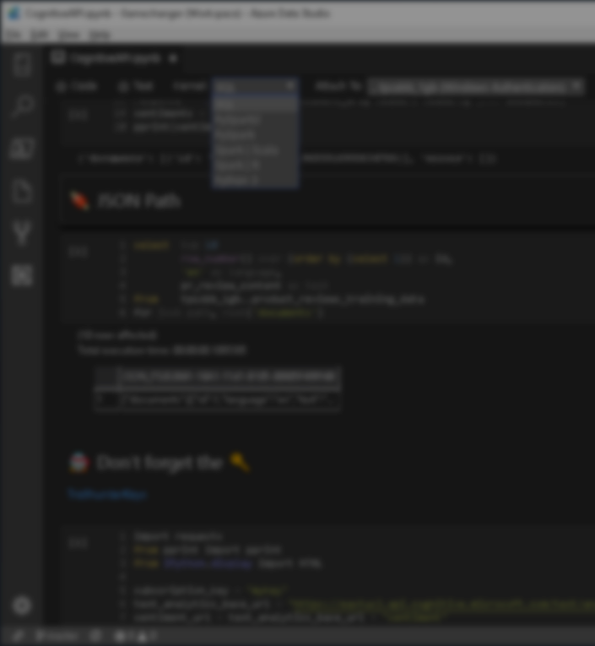

Session evaluations
This is the link:
bit.ly/ADF24
Your feedback is very important.
Submit your feedback by the end of this presentation.

Slide 12

Sponsor
1110 W Commercial Blvd, Fort Lauderdale, FL 33309 // Ph. (800) 425-9113 // universalproperty.com
Notes:
https://universalinsuranceholdings.com/career-details/

Slide 13
Hiram Fleitas
Owner Fleitas Arts
@hiramfleitas
Thank You
hiram@fleitasarts.com
fleitasarts.com
/hfleitas
hiramfleitas

